Slide 1


SQL Project
Music Store Analysis
- By Vivek Shirsat

Slide 2
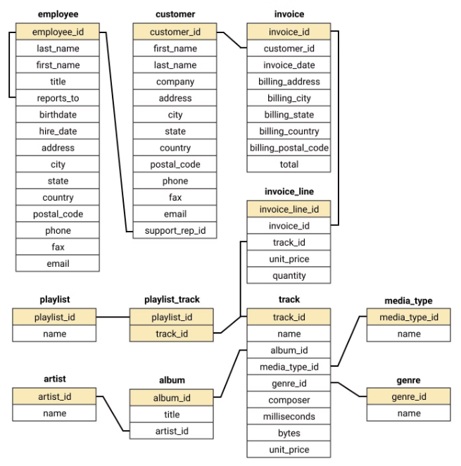
Schema
The schema for the music store database includes the following tables:
Customers
Employees
Invoices
InvoiceLines
Tracks
Albums
Artists
Genres
These tables store information about the customers, employees, invoices, invoice line items, music tracks, albums, artists, and genres in the music store.

Slide 3
Introduction
Welcome to my presentation on the "Music Store Analysis" project. This project aims to leverage SQL to analyze the dataset of an online music store. By delving into various aspects of the store's data, we seek to uncover valuable insights that can inform better business decisions and drive growth.
The primary objectives of this project are to:
Understand customer segmentation and preferences
Identify trends and patterns in music consumption
Evaluate artist effectiveness and growth
Analyze customer spending behaviors
By addressing these objectives, the analysis will help highlight key areas of the store's operations and provide actionable recommendations for enhancing performance and customer satisfaction.

Slide 4

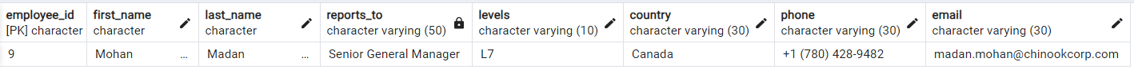
Senior Most Employee Query
Query :-
SELECT employee_id, first_name, last_name, title, reports_to, levels, country, phone, email
FROM employee
ORDER BY levels DESC
LIMIT 1;
Output :-

Slide 5

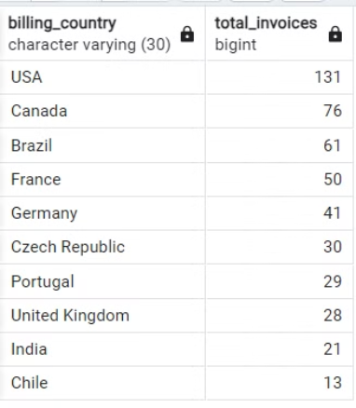
Countries with Most Invoices
Output :-
Query :-
SELECT billing_country ,
count(*) AS total_invoices
FROM invoice
GROUP BY billing_country
ORDER BY total_invoices DESC
LIMIT 10 ;

Slide 6
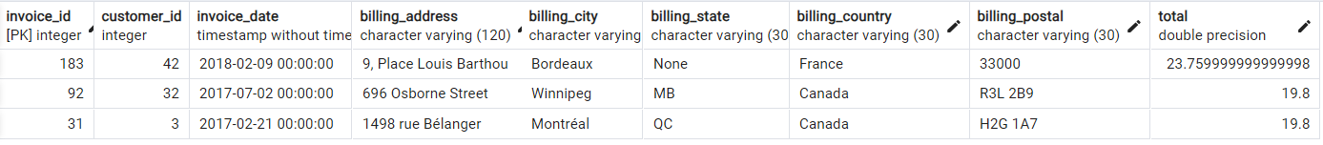
Top 3 Values of Total Invoice
Query :-
Output :-
SELECT *
FROM invoice
ORDER BY total desc
LIMIT 3;

Slide 7
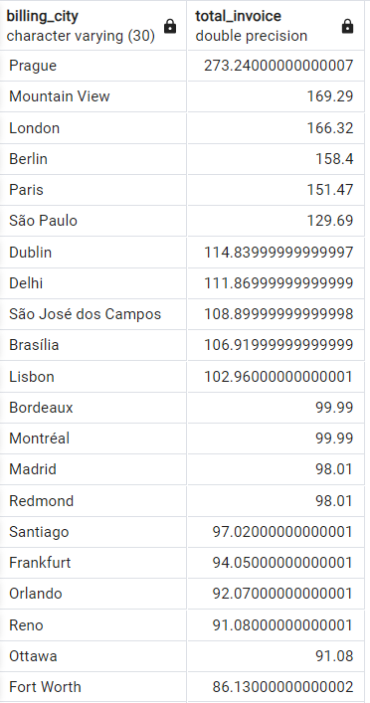
Identifying the Top City by Invoice Totals
Query :-
Output :-
SELECT billing_city, SUM(total) as total_invoice
FROM invoice
GEOUP BY billing_city
ORDER BY total_invoice DESC;

Slide 8

Identifying the Best Customer by Expenditure
Query :-
Output :-
SELECT c.first_name , c.last_name ,
SUM(i.total) total_spent
FROM customer as c
JOIN invoice as i
ON c.customer_id = i.customer_id
GROUP BY c.first_name, c.last_name
ORDER BY total_spent desc
LIMIT 1;

Slide 9
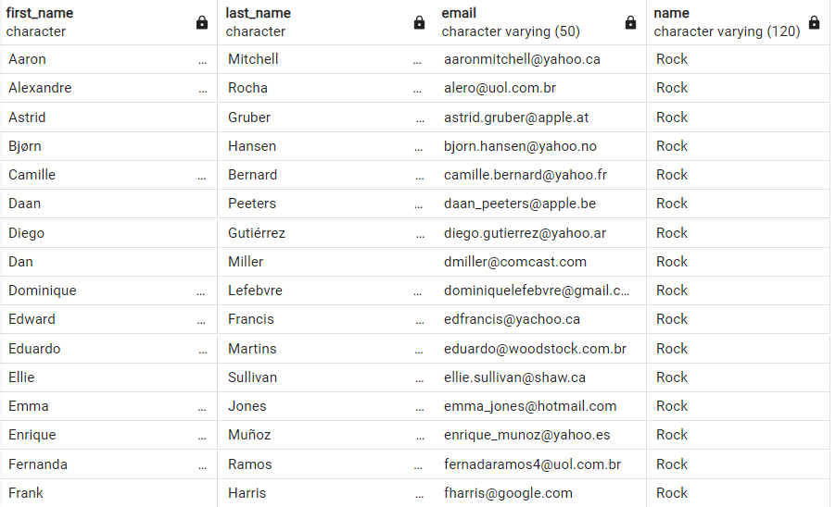
Listing Rock Music Listeners by Email
Query :-
Output :-
SELECT DISTINCT c.first_name , c.last_name, c.email, g.name
FROM customer as c
JOIN invoice as i
ON c.customer_id = i.customer_id
JOIN invoice_line as il
ON i.invoice_id = il.invoice_id
JOIN track as t
ON il.track_id = t.track_id
JOIN genre as g
ON t.genre_id = g.genre_id
WHERE g.name = 'Rock’
ORDER BY email ;

Slide 10
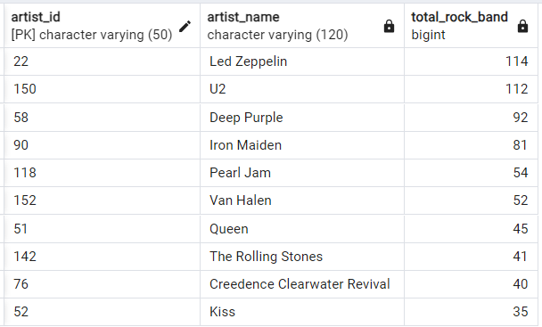
Top 10 Rock Bands by Track Count
Query :-
Output :-
SELECT ar.artist_id, ar.name as artist_name, COUNT(g.name) as total_rock_band
FROM artist as ar
JOIN album as al
ON ar.artist_id = al.artist_id
JOIN track as t
ON al.album_id = t.album_id
JOIN genre as g
ON t.genre_id = g.genre_id
WHERE g.name = 'Rock’
GROUP BY ar.artist_id
ORDER BY total_rock_band desc
LIMIT 10;

Slide 11
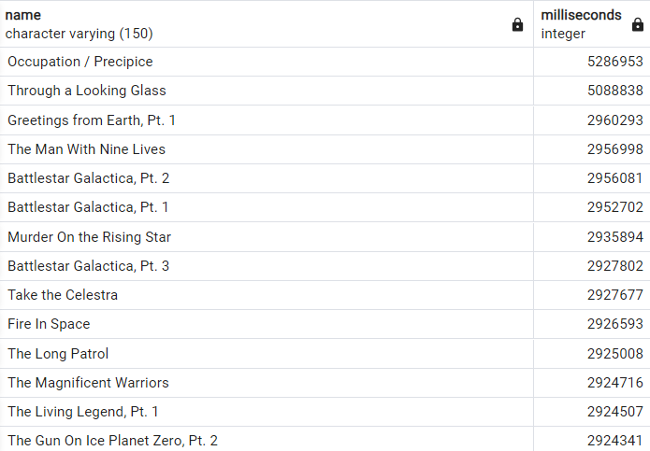
Tracks Longer Than Average Song Length
Query :-
Output :-
SELECT
name, milliseconds
FROM track
WHERE milliseconds >(SELECT
AVG(milliseconds) as avg_length
FROM track)
ORDER BY milliseconds desc;

Slide 12
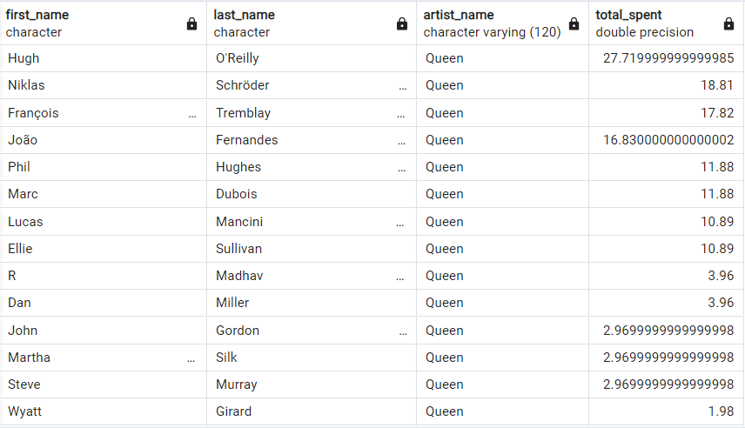
Customer Spending by Artist
Query :-
Output :-
WITH cte AS(
SELECT ar.artist_id,ar.name , sum(il.unit_price * il.quantity) as total_spent
FROM invoice_line as il
JOIN track as t on il.track_id = t.track_id
JOIN album as al on al.album_id = t.album_id
JOIN artist as ar on ar.artist_id = al.artist_id
GROUP BY 1
ORDER BY total_spent DESC
LIMIT 1)
SELECT c.first_name, c.last_name , ar.name as artist_name, SUM(il.unit_price * il.quantity) as total_spent
FROM customer as c
JOIN invoice as I on c.customer_id=i.customer_id
JOIN invoice_line as il on i.invoice_id = il.invoice_id
JOIN track as t on il.track_id = t.track_id
JOIN album as al on t.album_id = al.album_id
JOIN artist as ar on al.artist_id = ar.artist_id
JOIN cte as c1 on ar.artist_id = c1.artist_id
GROUP BY 1,2,3
ORDER BY total_spent desc;

Slide 13
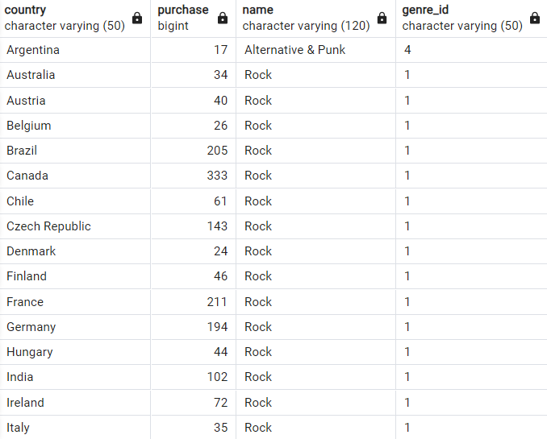
Most Popular Music Genre by Country
Query :-
Output :-
WITH cte AS (
SELECT c.country, count(il.quantity) as purchase, g.name, g.genre_id ,
row_number()over(partition by c.country order by count(il.quantity) desc) as rnk
FROM customer as c
JOIN invoice as i
on c.customer_id = i.customer_id
JOIN invoice_line as il
on i.invoice_id = il.invoice_id
JOIN track as t
on il.track_id = t.track_id
JOIN genre as g
on t.genre_id = g.genre_id
GROUP BY 1,3,4)
SELECT
country, purchase, name, genre_id
FROM cte
WHERE rnk = 1;

Slide 14
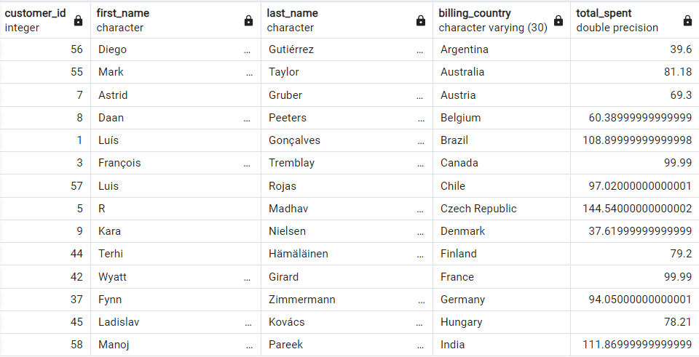
Top Spenders on Music by Country
Query :-
Output :-
WITH cte as (
SELECT
c.customer_id,c.first_name, c.last_name, i.billing_country, sum(i.total) as total_spent,
row_number()over(partition by i.billing_country order by sum(i.total) desc) as rnk
FROM customer as c
JOIN invoice as i
on c.customer_id = i.customer_id
GROUP BY 1,2,3,4
ORDER BY 5 desc)
SELECT customer_id, first_name, last_name, billing_country, total_spent
FROM cte
WHERE rnk = 1
ORDER BY billing_country asc;

Slide 15



Thank You !!

